Slide 1

Anime Rating Prediction
Soumita Mitra

Slide 2

Motivation to predict anime rating score

Slide 3
About the Dataset and Objective
In this Dataset we have 7030 observations and 16 columns. This dataset includes features like title, episode, duration, season of release, rating, votes, mediatype, watched, watching, wantwatch, dropped, tags, description, ongoing etc.
The objective of this project is o determine what factors play a role in overall rating and attempt to create a model to use these factors to predict rating.

Slide 4
Methodology
Data Preprocessing & Exploration
Feature Engineering & Selection
Train & Evaluate Model (Model Selection)

Slide 5
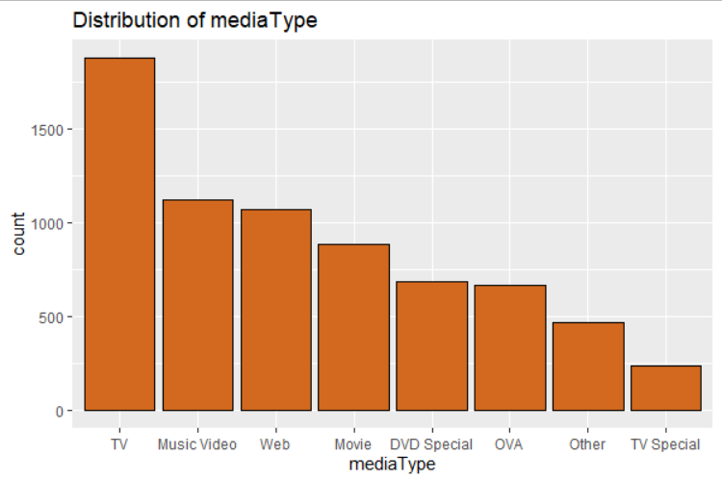
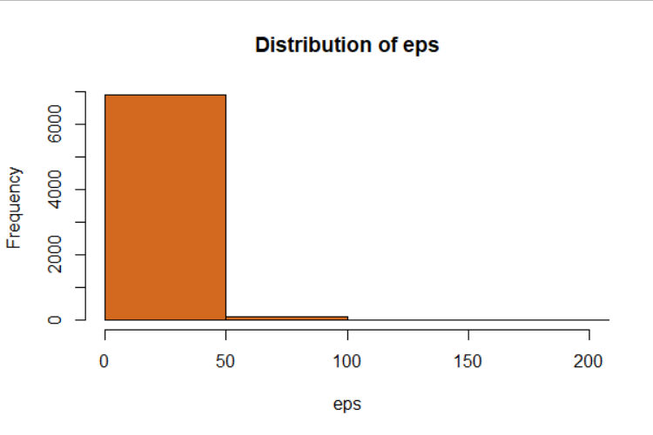
Nature of the variables
Most of the anime release in the platform ‘TV’.
Most of the animes contain 50 episodes.

Slide 6
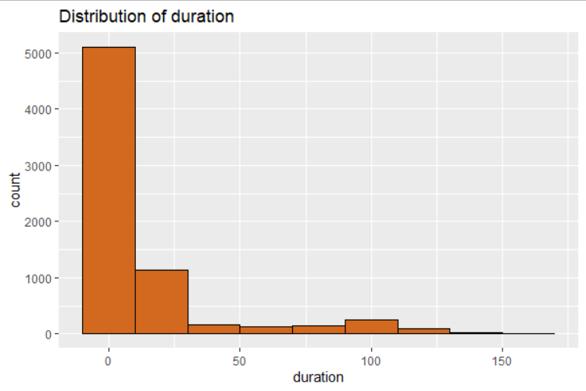
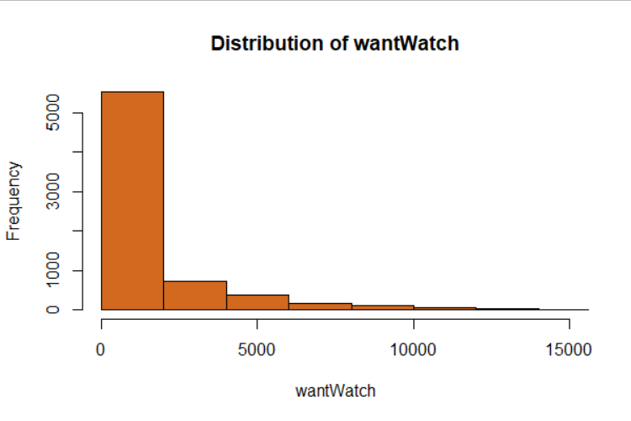
Maximum episodes have duration approximately 20 to 25 minutes.
Around 2000 people watches anime mostly.

Slide 7
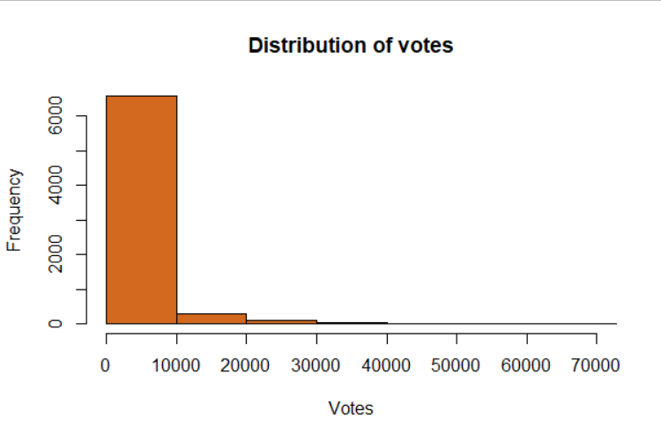
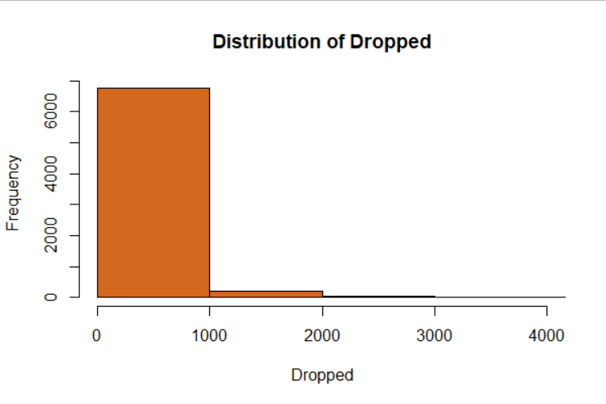
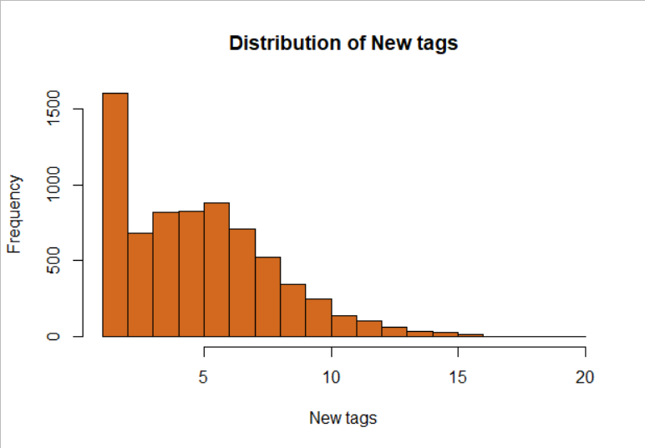

Slide 8
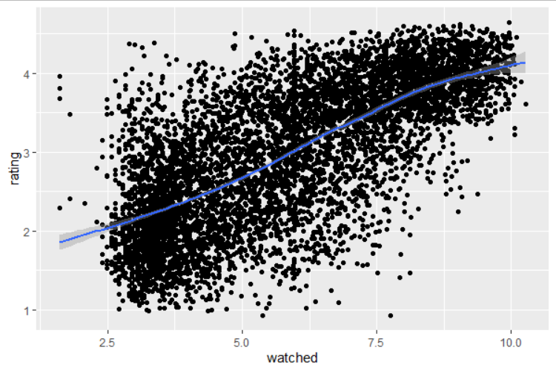
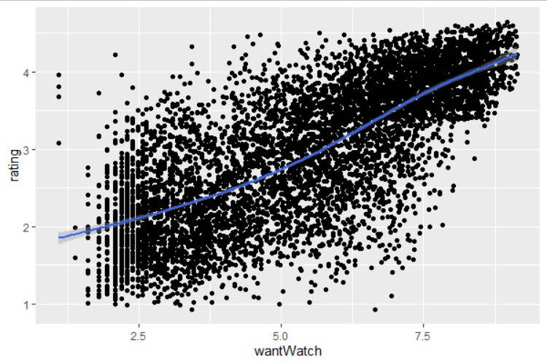
Bivariate Analysis
A strong positive correlation occurs between watched and rating.
Higher the no. of people watching Anime, higher will be the rating.
A strong positive correlation occurs between want to watch and rating.
As the no of people want to watch anime increase, rating increase.

Slide 9
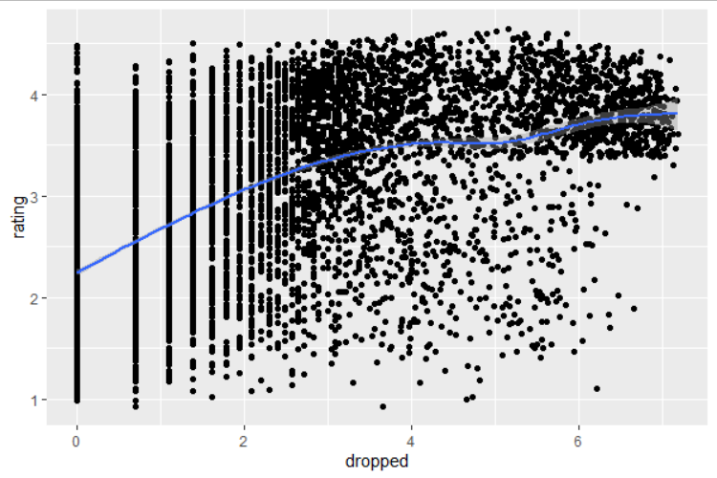
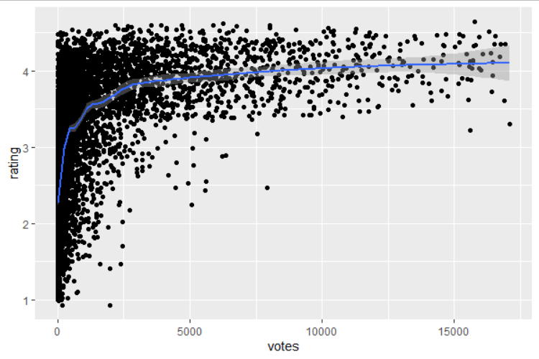
The lesser the drop rate the higher will be the rating.
Anime with higher number of votes are consistently rated high.

Slide 10
Model development and Validation
The significant variables in this model are:
Episode
Duration
Under media type Music video
Want to watch
Dropped
Votes
Newtags
The accuracy in the model :
The Mean Accuracy in the model is 16.53
The Median Accuracy in the model is 11.61

Slide 11
Business Recommendation
The estimate for the viewer’s response behaviour statistics (Want to watch, Votes) are positive.
Votes and want to watch are impacting the ratings positively. The production studio can focus on the strategies that can increase the number of votes.
Episode and duration also have a positive impact on ratings.
Under media type Music video is an important feature.
The estimated value for media type music video is positive. the production studios should focus more on Music Video

Slide 12
Thank You

